Slide 1
Forecasting future ratings of a cereal using statistical modelling in R
Group Project
OPIM 5603: Statistics in Business Analytics
Prof. Pankaj Prakash.
Team
Akash deep Konda
Harshitha Varimadugu
Mahesh Reddy
Lakshmi Ramya Marineni
Venkata Subramanya Sai Sasank Prakki

Slide 2
Introduction
The dataset includes the names of various cereals produced by the five separate companies. Calories, Protein, Fat, Sodium, Fiber, carbohydrates, Sugars, Potassium, and Vitamin Content are all listed for each cereal. There are 80 different types of cereals in this collection.
Our endeavor entails forecasting future ratings based on the information we have. It assists manufacturers in maintaining the contents of a cereal that customers enjoy. As a result, cereal manufacturing enterprises will be more profitable.

Slide 3
Problem Statement
To clean the data by missing values and outlier analysis.
To visualize the trends in plots between rating and each of the other variables in the dataset.
To construct a model based on subset of variables in cereal data to predict future rating of cereals.

Slide 4
Data cleaning
Outliers
Missing Values

Slide 5
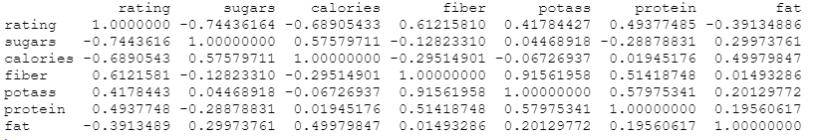
Data Exploration
Correlation Analysis

Slide 6
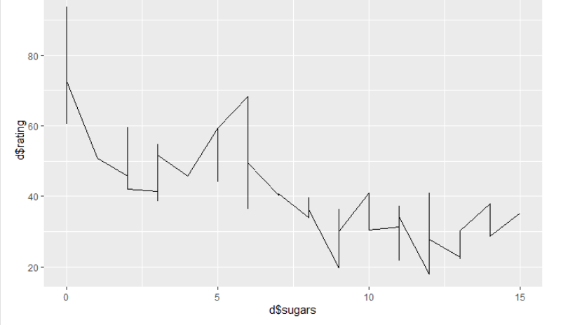
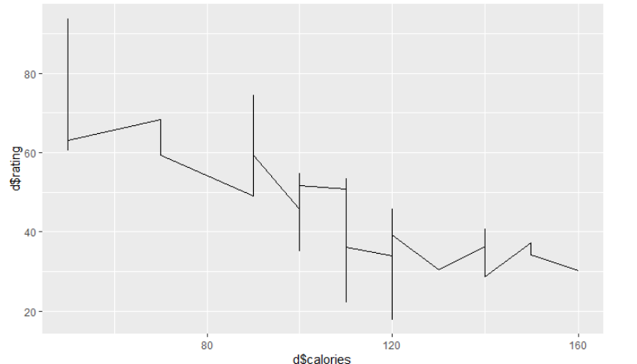
Data Visualization
Rating vs Sugars
Rating vs Calories

Slide 7
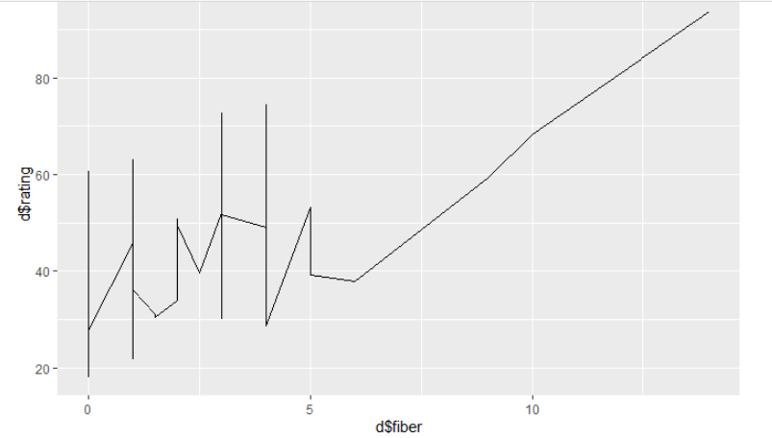
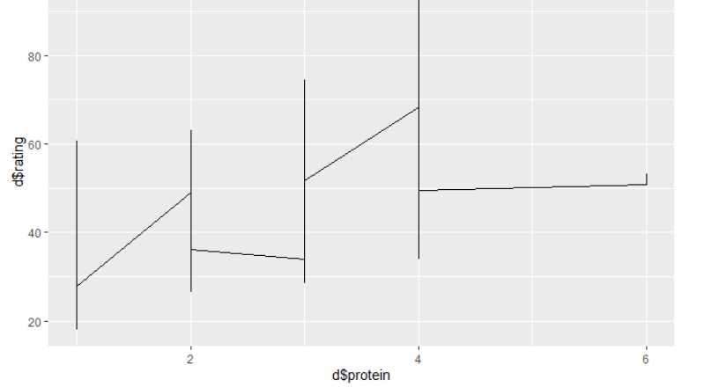
Data Visualization
Rating vs Fiber
Rating vs Protein

Slide 8
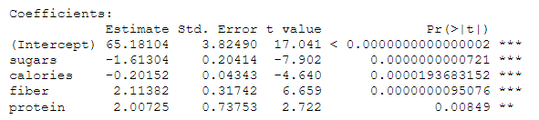

Modelling
Multiple Regression Model

Slide 9
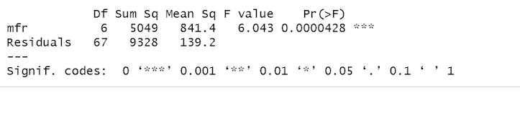
ANOVA
The null hypothesis (H0): There is no difference in means
Alternate hypothesis (Ha): The means are different from one another
The p-value of the mfr variable is low (p < 0.01), so it appears that the mfr has a real impact on the cereal rating.

Slide 10
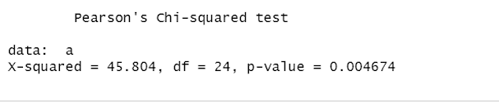
Chi Square test
Chi Square test is performed to estimate whether two variables (mfr and fat) are associated or related by a function.
H0: The two variables (mfr, fat) are independent.
H1: The two variables (mfr, fat) relate to each other.
p-Value less than the significance level of 0.05, we reject the null hypothesis and conclude that the two variables mfr and fat are in fact dependent.

Slide 11
Conclusion
“Cereal” is a dataset that shows data gathered from different types of cereals.
We performed data cleaning, exploratory data analysis to extract information from the data and then we performed data visualization to gain a clear idea on the information by giving it visual context through graphs.
We have performed multiple regression analysis to find the significance of variable in the model.
By knowing the trends in ratings, can help in predicting the future forecast of cereal ratings.

Slide 12
Recommendations
We can suggest that Manufacturers that want to bring in high ratings in future should create cereals that are high in fiber, protein and avoid creating cereals with high calorie counts or lots of sugar or fat.
We can extend our recommendations by saying Cereals with high ratings are more likely to be placed on the first or third shelf, because that is generally where the consumers’ eyes gravitate.

Slide 13

Thank You

Slide 14

References
https://www.kaggle.com/jeandsantos/breakfast-cereals-data-analysis-and-clustering/data
https://stats.libretexts.org/Courses/Las_Positas_College/Math_40%3A_Statistics_and_Probability/11%3A_Chi-Square_and_Analysis_of_Variance_(ANOVA)
http://r-statistics.co/Linear-Regression.html
http://www.sthda.com/english/articles/40-regression-analysis/168-multiple-linear-regression-in-r/

